Slide 1
Module 1

Slide 2
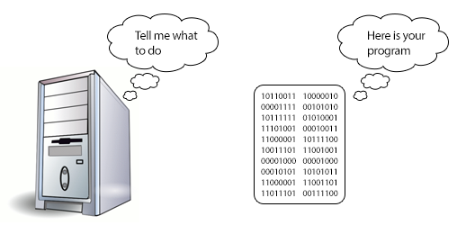
What is Programming?
Programming is the process of writing an algorithm into a sequence of computer instructions. Or you can simply say it is the process of writing programs.
The process of transforming the solution of a specific problem into computer language.
Programming requires skill, logical thinking and lots of experience.

Slide 3
Who is a Programmer?
Programmers are the person who writes programs in a specific computer programming language.
They are highly skilled, hard working, problem solvers.
The world’s first programmer was Ada Lovelace. She was widely known for her work on Charles Babbage’s Analytical Engine

Slide 4
Classification of Programming Languages
Different languages have different purposes. Some types are:
Machine languages, that are interpreted directly in hardware
Assembly languages, that are thin wrappers over a corresponding machine language
High-level languages, that are anything machine-independent
System languages, that are designed for writing low-level tasks, like memory and process management
Scripting languages, that are generally extremely high-level and powerful
Domain-specific languages, that are used in highly special-purpose areas only
Visual languages, that are non-text based
Esoteric languages, that are not really intended to be used, but are very interesting, funny, or educational in some way
These types are not mutually exclusive: Perl is both high-level and scripting; C is considered both high-level and system.

Slide 5
Assembler Vs Compiler Vs Interpreter
Compiler :
Compilers are used to convert high level languages (like C, C++ ) into machine code .
Example : gcc , Microsoft Visual Studio
Assembers :
Assembler are used to convert assembly language code into machine code.
Examples : List of assembler
Interpreter :
An interpreter is a computer program which executes a statement directly (at runtime).
Examples: python , LISP

Slide 6
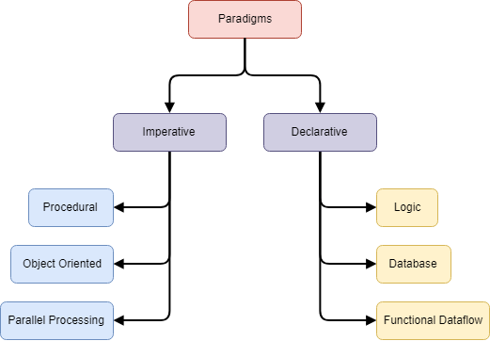
Programming paradigms
There are many different approaches to computer programming. These are called programming paradigms.
Different approaches develop solutions to problems using programs using different paradigms.
Even though most of the programming languages come under one paradigm type, certain languages show elements related to different paradigms.
There are a number of programming languages. There are differences among different programming language types.

Slide 7
Imperative Programming
Imperative programming is the style of programming in which there is a sequence of statements that change the state of the program.
The state of the total variable changed from 0 in the beginning of the program, to 6 before the print function.
Imperative programming says how to do something. An example - the process of baking a cake.
The program says how to do something in the correct sequence it should be done, therefore order of execution (the order in which each statement is executed) is important
Example :
var total = 0;
var a = 1;
var b = 5;
total = a + b
print total;

Slide 8
Declarative Programming
Declarative programming is a programming paradigm … that expresses the logic of a computation without describing its control flow.
Examples would be HTML, XML, CSS, SQL, Prolog, Haskell, F#and Lisp.
Declarative code focuses on building logic of software without actually describing its flow. You are saying what without adding how.
For example with HTML you use <img src="./image.jpg" />
To tell browser to display an image and you don’t care how it does that.
Imperative: C, C++, Java
Declarative: SQL, HTML
(Can Be) Mix: JavaScript, C#, Python

Slide 9
Example of Imperative and equivalent in Declarative

Slide 10
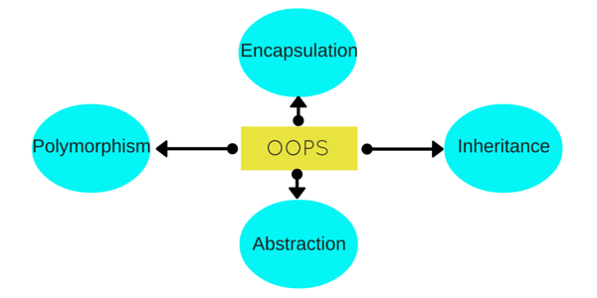
OBJECT ORIENTED PROGRAMMING - OOP
Object Oriented Programming is a popular methodology of programming any application.
Java, is an Object Oriented Programming language.
It allows users create the objects that they want and then create methods to handle those objects.
Manipulating these objects to get results is the goal of Object Oriented Programming
Object Oriented programming is a programming paradigm that is associated with the concept of Class and Objects
The four principles of object-oriented programming are,
Encapsulation
Abstraction
Inheritance
Polymorphism.

Slide 11
OBJECT ORIENTED PROGRAMMING - OOP
OOP is designed in such a way that one should focus on an object while programming and not the procedure.
An object can be anything that we see around us.
Object oriented programming brings programming close to real life, as we are always dealing with an object, performing operations on it, using it's methods and variables etc.

Slide 12
WHY OOPS
OOP provides a clear modular structure for programs
OOP makes it easy to maintain and modify existing code
OOP provides a good framework for code libraries where supplied software components can be easily adapted and modified by the programmer.
Code Reusability
It is suitable for real world problems and real world works
OOPs lets the coder to change the implementation of an object without affecting any other code. (Encapsulation)
OOPs lets the coder to think about what should be exposed to the outside world and what should be hidden. (Abstraction)
OOPs allows the coder to have many different functions, all with the same name, all doing the same job, but on different data. (Polymorphism)
OOPs lets the coder to write a set of functions, then expand them in different direction without changing or copying them in any way. (Inheritance)

Slide 13
OOP - CLASS
A class is a template or blueprint that is used to create objects.
The class is a group of similar entities.
A class consists of Data members and methods.
The member functions determine the behavior of the class, i.e. provide a definition for supporting various operations on data held in the form of an object.
It is only an logical component and not the physical entity.
For example, if you had a class called “Expensive Cars” it could have objects like Mercedes, BMW, Toyota, etc. Its properties(data) can be price or speed of these cars. While the methods may be performed with these cars are driving, reverse, braking etc.

Slide 14
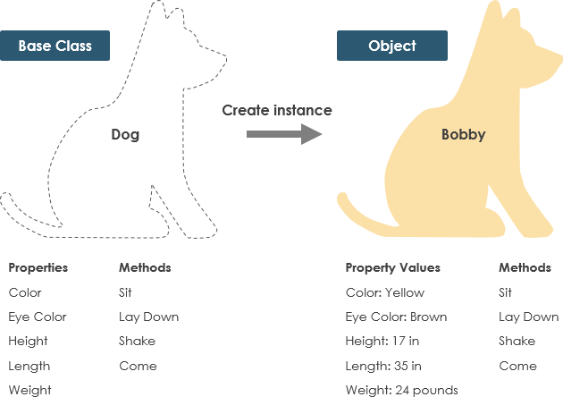
OOP - OBJECTS
In real-world an entity that has state and its behavior is known as an object.
In terms of object-oriented programming, software objects also have a state and behavior.
For Example:
A Car is an object. It has states (name, color, model) and its behavior (changing gear, applying brakes).
A Pen is an object. Its name is Parker; color is silver etc. known as its state. It is used to write, so writing is its behavior.

Slide 15
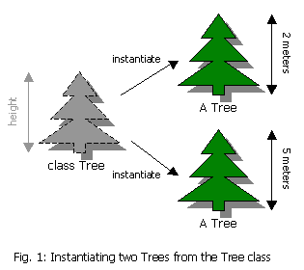
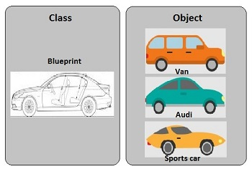
OOP - OBJECTS
An object can be defined as an instance of a class, and there can be multiple instances of a class in a program.
An Object contains both the data and the function, which operates on the data.

Slide 16
OOP - ENCAPSULATION
Encapsulation is the technique used to implement abstraction in object-oriented programming. Encapsulation is used for access restriction to class members and methods.
Enclosing one or more details from outside world (Private) through access rights.
Other objects don’t have direct access to this state. Instead, they can only call a list of public functions — called methods
The object manages its own state via methods — and no other class can touch it unless explicitly allowed.
If you want to communicate with the object, you should use the methods provided.
But (by default), you can’t change the state

Slide 17
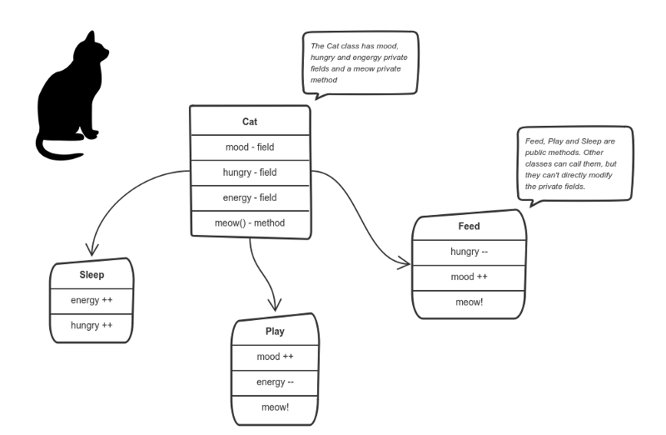
OOP - Encapsulation

Slide 18
OOP - Encapsulation
The “state” of the cat is the private variables mood, hungry and energy. It also has a private method meow(). It can call it whenever it wants, the other classes can’t tell the cat when to meow.
What they can do is defined in the public methods sleep(), play() and feed().
Each of them modifies the internal state somehow and may invoke meow(). Thus, the binding between the private state and public methods is made.
This is encapsulation.

Slide 19
OOP - ABSTRACTION
Abstraction can be thought of as a natural extension of encapsulation
Abstraction is the concept of hiding the internal details (implementation) and describing things in simple terms.
Revealing relevant/necessary information and hiding the unwanted information is abstraction.
Object-oriented design, programs are often extremely large.
And separate objects communicate with each other a lot. So maintaining a large codebase like this for years — with changes along the way — is difficult.
Abstraction is a concept aiming to ease this problem
EXAMPLE
In a mobile phone, dialing a number would call some method internally which will concatenate the numbers and displays it on screen but, we don’t know what is happening internally.
When you tap on the call option, it is sending signals to other person’s mobile(whom you are trying to call) but we are unaware of it’s implementation.

Slide 20
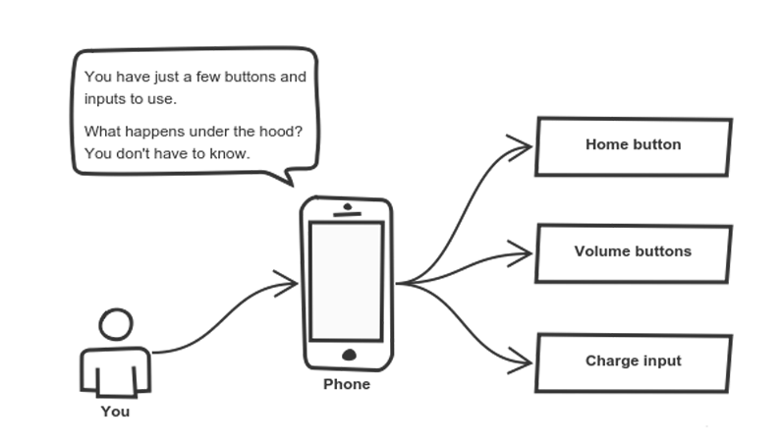
OOP - ABSTRACTION
You interact with your phone by using only a few buttons. But implementation details are hidden.
Only a short set of actions are known.
Implementation changes — for example, a software update — rarely affect the abstraction you use.
Cell phones are complex. But using them is simple.

Slide 21
OOP - POLYMORPHISM
Polymorphism means “many shapes” in Greek.
Polymorphism is the concept where an object behaves differently in different situations.
Performing a job in different ways.(One to many)
Polymorphism gives a way to use a class exactly like its parent so there’s no confusion with mixing types. But each child class keeps its own methods as they are.
For example, in English, the verb run has a different meaning if you use it with a laptop, a foot race, and business. Here, we understand the meaning of run based on the other words used along with it.The same also applied to Polymorphism.
EXAMPLE
We click photographs and record videos using the camera in a mobile phone.
Various brands have a plethora of camera modes in a mobile like: split camera/panaroma/slow-mo.
The basic purpose is to click/record, so the functionality of camera is the same in every mobile, whereas the modes enable you to use your camera in different ways.

Slide 22
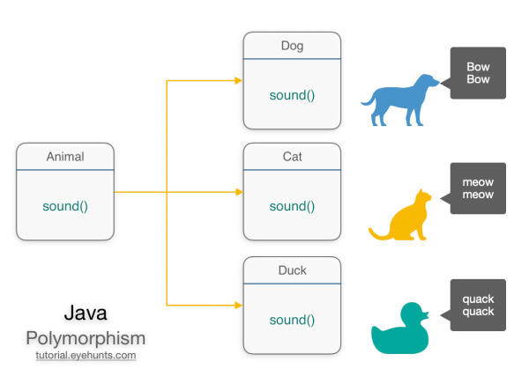
OOP - POLYMORPHISM

Slide 23
OOP - INHERITANCE
Inheritance is the object oriented programming concept where an object is based on another object
Inheritance is the mechanism of code reuse.
The object that is getting inherited is called superclass and the object that inherits the superclass is called subclass.
Example:
The basic purpose of using a mobile phone is communication.
There are several brands in mobiles. So, the brands of a mobile are using this basic functionality(communication) by extending the mobile class functionality and adding their own new features to their respective brands.

Slide 24
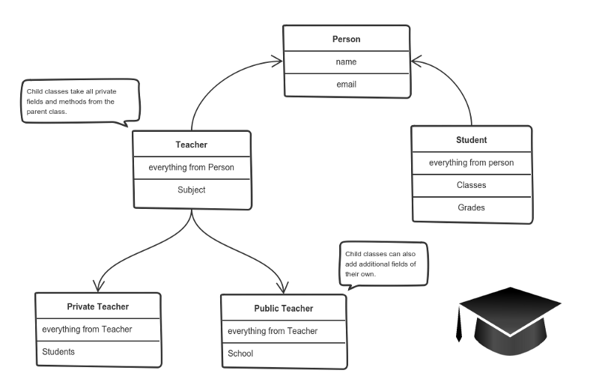
OOP - INHERITANCE
By Inheriting each class adds only what is necessary for it while reusing common logic with the parent classes
A private teacher is a type of teacher. And any teacher is a type of Person.

Slide 25
MCQ Based on OOPS Concept
Which of the following best defines a class? a) Parent of an object b) Instance of an object c) Blueprint of an object d) Scope of an object
Which Feature of OOP illustrated the code reusability? a) Polymorphism b) Abstraction c) Encapsulation d) Inheritance

Slide 26
MCQ Based on OOPS Concept
Which language does not support all 4 types of inheritance? a) C++ b) Java c) Kotlin d) Small Talk
Why Java is Partially OOP language? a) It supports usual declaration of primitive data types b) It doesn’t support all types of inheritance c) It allows code to be written outside classes d) It does not support pointers
Notes:
4. Answer: a Explanation: As Java supports usual declaration of data variables, it is partial implementation of OOP. Because according to rules of OOP, object constructors must be used, even for declaration of variables.

Slide 27
MCQ Based on OOPS Concept
Which concept of OOP is false for C++? a) Code can be written without using classes b) Code must contain at least one class c) A class must have member functions d) At least one object should be declared in code
Which of the two features match each other? a) Inheritance and Encapsulation b) Encapsulation and Polymorphism c) Encapsulation and Abstraction d) Abstraction and Polymorphism
Notes:
5. Answer: b Explanation: In C++, it’s not necessary to use classes, and hence codes can be written without using OOP concept. Classes may or may not contain member functions, so it’s not a necessary condition in C++. And, an object can only be declared in a code if its class is defined/included via header file.
6. Answer: c Explanation: Encapsulation and Abstraction are similar features. Encapsulation is actually binding all the properties in a single class or we can say hiding all the features of object inside a class. And Abstraction is hiding unwanted data (for user) and showing only the data required by the user of program.

Slide 28
MCQ Based on OOPS Concept
Which feature allows open recursion, among the following? a) Use of this pointer b) Use of pointers c) Use of pass by value d) Use of parameterized constructor
Class is pass by _______ a) Value b) Reference c) Value or Reference, depending on program d) Copy
Notes:
7. Answer: a Explanation: Use of this pointer allows an object to call data and methods of itself whenever needed. This helps us call the members of an object recursively, and differentiate the variables of different scopes.
8. Answer: b Explanation: Classes are pass by reference, and the structures are pass by copy. It doesn’t depend on program.

Slide 29
MCQ Based on OOPS Concept
Size of a class is : a) Sum of size of all the variables declared inside the class b) Sum of size of all the variables along with inherited variables in the class c) Size of largest size of variable d) Classes doesn’t have any size
Which class can have member functions without their implementation? a) Default class b) String class c) Template class d) Abstract class
Notes:
9. Answer: d Explanation: Classes doesn’t have any size, actually the size of object of the class can be defined. That is done only when an object is created and its constructor is called.
10. Answer: d Explanation: Abstract classes can have member functions with no implementation, where the inheriting subclasses must implement those functions.

Slide 30
MCQ Based on OOPS Concept
Class with main() function can be inherited (True/False) a) True b) False
Which of the following pairs are similar? a) Class and object b) Class and structure c) Structure and object d) Structure and functions
Notes:
11. Answer: a Explanation: The class containing main function can be inherited and hence the program can be executed using the derived class names also in java.
12. Answer: b Explanation: Class and structure are similar to each other. Only major difference is that a structure doesn’t have member functions whereas the class can have both data members and member functions.

Slide 31
MCQ Based on OOPS Concept
Instance of which type of class can’t be created? a) Anonymous class b) Nested class c) Parent class d) Abstract class
Which of the following pairs are similar? a) Class and object b) Class and structure c) Structure and object d) Structure and functions
Notes:
13. Answer: d Explanation: Instance of abstract class can’t be created as it will not have any constructor of its own, hence while creating an instance of class, it can’t initialize the object members. Actually the class inheriting the abstract class can have its instance, because it will have implementation of all members.
14. Answer: b Explanation: Class and structure are similar to each other. Only major difference is that a structure doesn’t have member functions whereas the class can have both data members and member functions.

Slide 32
MCQ Based on OOPS Concept
If a function can perform more than 1 type of tasks, where the function name remains same, which feature of OOP is used here? a) Encapsulation b) Inheritance c) Polymorphism d) Abstraction
If different properties and functions of a real world entity is grouped or embedded into a single element, what is it called in OOP language? a) Inheritance b) Polymorphism c) Abstraction d) Encapsulation
Notes:
15. Answer: d Explanation: Instance of abstract class can’t be created as it will not have any constructor of its own, hence while creating an instance of class, it can’t initialize the object members. Actually the class inheriting the abstract class can have its instance, because it will have implementation of all members.
12. Answer: d Explanation: It is Encapsulation, which groups different properties and functions of a real world entity into single element. Abstraction, on other hand, is hiding of functional or exact working of codes and showing only the things which are required by the user.

Slide 33
MCQ Based on OOPS Concept
How many basic features of OOP are required for a programming language to be purely OOP? a) 7 b) 6 c) 5 d) 4
The feature by which one object can interact with another object is: a) Data transfer b) Data Binding c) Message Passing d) Message reading
Notes:
17. Answer: a Explanation: There are 7 basic features that define whether a programing language is pure OOP or not. The 4 basic features are inheritance, polymorphism, encapsulation and abstraction. Further, one is, object use is must, secondly, message passing and lastly, Dynamic binding.
18. Answer: c Explanation: The interaction between two object is called message passing feature. Data transfer is not feature of OOP. Also, message reading is not feature of OOP.

Slide 34
MCQ Based on OOPS Concept
The feature by which one object can interact with another object is: a) Data transfer b) Data Binding c) Message Passing d) Message reading
Exception handling is feature of OOP. (True/False) a) True b) False
Notes:
18. Answer: c Explanation: The interaction between two object is called message passing feature. Data transfer is not feature of OOP. Also, message reading is not feature of OOP.
20. Answer: a Explanation: Exception handling is feature of OOP as it includes classes concept in most of the cases. Also it may come handy while using inheritance.

Slide 36
MODULE 1 – Session 3

Slide 37
Variables
Variable is a piece of memory that can contain a data value.
A variable thus has a data type
Variables are typically used to store information
This can be any kind of information ranging from texts, codes (e.g. country codes, currency codes etc.) to numbers, temporary results of multi step calculations etc.

Slide 38
Java Variable Types
In Java there are four types of variables:
Non-static fields - A non-static field is a variable that belongs to an object. Objects keep their internal state in non-static fields. Non-static fields are also called instance variables, because they belong to instances (objects) of a class.
Static fields - A static field is a variable that belongs to a class. A static field has the same value for all objects that access it. Static fields are also called class variables.
Local variables - A local variable is a variable declared inside a method. A local variable is only accessible inside the method that declared it
Parameters - A parameter is a variable that is passed to a method when the method is called. Parameters are also only accessible inside the method that declares them.

Slide 39
Data Type
A data type, in programming, is a classification that specifies,
Which type of value a variable has
And what type of mathematical, relational or logical operations can be applied to it without causing an error.
A string, for example, is a data type that is used to classify text and an integer is a data type used to classify whole numbers.
The data type defines which operations can safely be performed to create, transform and use the variable in another computation.
Data Type | Used for | Example
String | Alphanumeric characters | hello world, Alice, Bob123
Integer | Whole numbers | 7, 12, 999
Float (floating point) | Number with a decimal point | 3.15, 9.06, 00.13
Character | Encoding text numerically | 97 (in ASCII, 97 is a lower case 'a')
Boolean | Representing logical values | TRUE, FALSE

Slide 40
Strongly Typed And Weakly Typed
Strongly Typed :
Variable must be declared with a data type.
A variable cannot start off life without knowing the range of values it can hold, and once it is declared, the data type of the variable cannot change.
A strongly typed language requires an explicit conversion (by using the cast operator) between related types
Java is a strongly typed programming language
Weakly Typed :
Variables are not associated to specific datatype
Weakly typed languages place no restrictions on how data types can be mixed.
Conversions between unrelated types are implicitly allowed.
Example : Perl

Slide 41
Data Types in Java
Data types specify the type of the values stored in variable. Two types of data types in java are
1. Primitive data types: The primitive data types include Boolean, char, byte, short, int, long, float and double.
2. Non-primitive data types: The non-primitive data types include Classes, Interfaces, and Arrays.

Slide 42
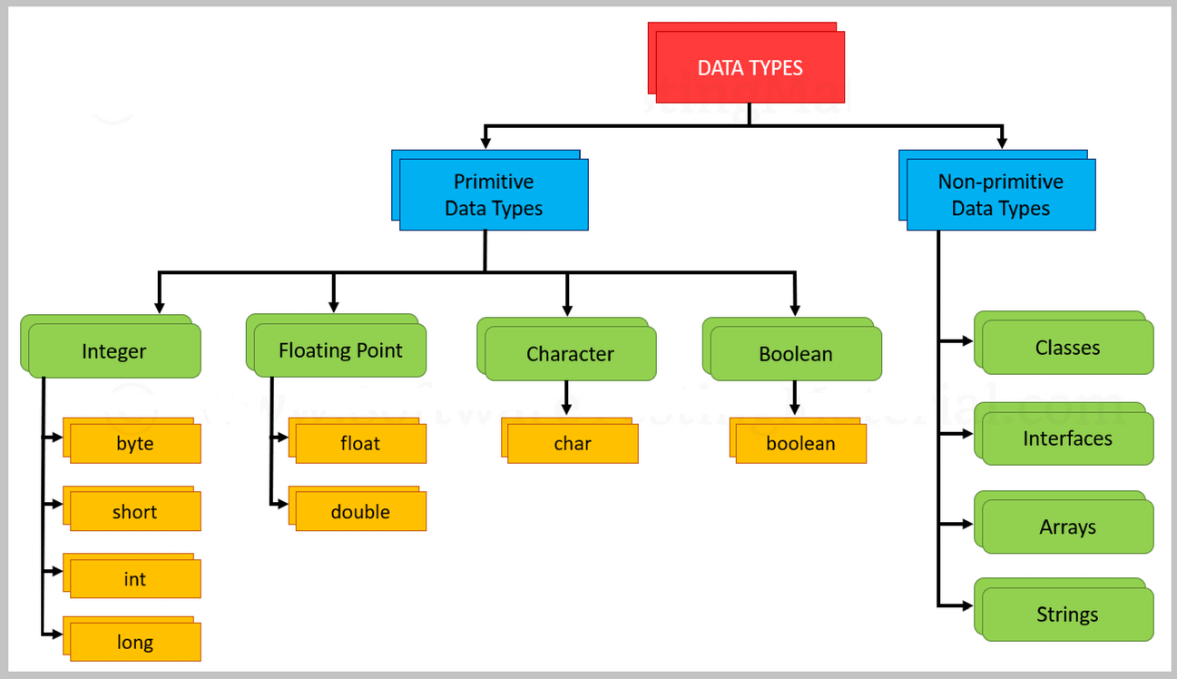

Slide 43
Java - Data Types and their Range
Data Type | Default Value | Default size | Range
boolean | false | 1 bit | true or false
char | '\u0000' | 2 byte | 0 to 65535
byte | 0 | 1 byte | -128 to 127
short | 0 | 2 byte | -32,768 to 32,767
int | 0 | 4 byte | -2³¹ to 2³¹-1
long | 0L | 8 byte | -2⁶³ to 2⁶³-1
float | 0.0f | 4 byte | 1.4e-324 to 3.4e+038
double | 0.0d | 8 byte | 4.9e-324 to 1.8e+308

Slide 44
Points to Remember:
All numeric data types are signed (+/-).
The size of data types remain the same on all platforms (standardized)
Char data type in Java is 2 bytes because it uses UNICODE character set. By virtue of it, Java supports internationalization.
UNICODE is a character set which covers all known scripts and language in the world
Literals
Literals are used to indicate simple values in your Java programs
Different kinds of Literals in java are,
numbers
characters
strings
boolean values

Slide 45
1. Numbers
Byte, int, long, and short can be expressed in decimal(base 10), hexadecimal(base 16) or octal(base 8) number systems as well.
byte a = 68;
char a = 'A'
int decimal = 100;
int octal = 0144;
int hexa = 0x64;
int binary = 0b1111;

Slide 46
2. Characters and String
String literals in Java are specified like they are in most other languages by enclosing a sequence of characters between a pair of double quotes.
Examples of string literals are −
"Hello World"
"two\nlines"
"\"This is in quotes\""
Character literals are expressed by a single character surrounded by single quotes: ’a’, ’#’, ’3’, and so on. Characters are stored as 16-bit Unicode characters
String and char types of literals can contain any Unicode characters.
For example −
char a = '\u0001';
String a = "\u0001";

Slide 47
3. Boolean literals
Boolean literals consist of the keywords true and false. These keywords can be used anywhere you need a test or as the only possible values for Boolean variables.

Slide 48
MCQ Based on Data Types

Slide 49
Java Variable Example:
Add Two Numbers
class Simple{
public static void main(String[] args){
int a=10;
int b=10;
int c=a+b;
System.out.println(c);
}
}
Output:
20

Slide 50
Java Variable Example:
Widening
class Simple{
public static void main(String[] args){
int a=10;
float f=a;
System.out.println(a);
System.out.println(f);
}
}
Output:
10
10.0

Slide 51
Java Variable Example:
Overflow
class Simple{
public static void main(String[] args){
//Overflow
int a=130;
byte b=(byte)a;
System.out.println(a);
System.out.println(b);
}
}
Output:
130
-126

Slide 52
Java Variable Example:
Narrowing (Typecasting)
class Simple{
public static void main(String[] args){
float f=10.5f;
//int a=f;//Compile time error
int a=(int)f;
System.out.println(f);
System.out.println(a);
}
}
Output:
10.5
10

Slide 53
Java Variable Example:
Adding Lower Type
class Simple{
public static void main(String[] args){
byte a=10;
byte b=10;
//byte c=a+b;//Compile Time Error: because a+b=20 will be int
byte c=(byte)(a+b);
System.out.println(c);
}
}
Output:
20

Slide 54
Q) Why char uses 2 byte in java and what is \u0000 ?
It is because java uses Unicode system not ASCII code system.
The \u0000 is the lowest range of Unicode system.

Slide 55
Unicode System
Unicode is a universal international standard character encoding that is capable of representing most of the world's written languages.
Why java uses Unicode System?
Before Unicode, there were many language standards: ASCII (American Standard Code for Information Interchange) for the United States.
ISO 8859-1 for Western European Language.
KOI-8 for Russian.
GB18030 and BIG-5 for chinese, and so on.
lowest value:\u0000
highest value:\uFFFF

Slide 56
MCQs
1. Which code fragment correctly assign a numeric literal?
A) byte b1 = b1011;
B) byte b2 = 1011b;
C) byte b3 = 0b1001;
D) byte b4 = 0xb001;
Notes:
C

Slide 57
2. Given the fragment:
public class MathFun {
public static void main(String[] args) {
int number1 = 0b0111;
int number2 = 0111_000;
System.out.println("Number1: " + number1);
System.out.println("Number2: " + number1);
}
}
What is the result?
OPTIONS :
A) Number1: 7
Number2: 7
B) Number1: 7
Number2: 111_000
C) Number1: 0b0111
Number2: 0111000
D) Compilation fails.
Notes:
A

Slide 58
3. class Main {
public static void main(String args[]) {
int t;
System.out.println(t);
}
}
4. Automatic type conversion in Java takes place when
OPTIONS
(A) 0
(B) garbage value
(C) compiler error
(D) runtime error
OPTIONS :
A. Two type are compatible and size of destination type is shorter than source type.
B. Two type are compatible and size of destination type is equal of source type.
C. Two type are compatible and size of destination type is larger than source type.
D. All of the above
Notes:
3) C
4) C

Slide 59
5. What is the output of the following program?
class A{
public static void main(String args[]){
byte b;
int i = 258;
double d = 325.59;
b = (byte) i;
System.out.print(b);
i = (int) d;
System.out.print(i);
b = (byte) d;
System.out.print(b);
}
}
OPTIONS
A. 258 325 325
B. 258 326 326
C. 2 325 69
D. Error
Notes:
C

Slide 60
6. What is the output of the following program?
public class Test{
public static void main(String [] a){
Scanner s= new Scanner(System.in);
int a=s.nextInt();
String str=s.nextLine();
System.out.println(a+” “+str);
}
}
INPUT :
5
Hello
OPTIONS :
a) Hello
b) 5 Hello
c) 5
d) 5Hello

Slide 61
7. What will be output of the following program code?
public class Test{
public static void main(String[] a){
short x = 10;
x = x*5;
System.out.print(x);
}
}
OPTIONS :
A. 50
B. 10
C. Compilation Error
D. None of these

Slide 62
8. The following program:
public class Test{
static boolean isOK;
public static void main(String args[]){
System.out.print(isOK);
}
}
OPTIONS :
A. Prints true
B. Prints false
C. Will not compile as boolean is not initialized
D. Will not compile as boolean can never be static

Slide 63
9. What will be the output of the program?
class Equals
{
public static void main(String [] args)
{
int x = 100;
double y = 100.1;
boolean b = (x = y); /* Line 7 */
System.out.println(b);
}
}
OPTIONS :
A. true
B. false
C. Compilation fails
D. An exception is thrown at runtime

Slide 64
10. What is the output for the below code ?
1. public class Test{
2. public static void main(String[] args){
3. int i = 010;
4. int j = 07;
5. System.out.println(i);
6. System.out.println(j);
7. }
8. }
OPTIONS :
A. 8 7
B. 10 7
C. Compilation fails with an error at line 3
D. Compilation fails with an error at line 5
E. None of these

Slide 65
11. Select from among the following character escape code which is not available in Java.
OPTIONS :
A. t
B. r
C. a
D. \
E. “
12. .Determine output:
public class Test{
public static void main(String... args){
int a=5 , b=6, c=7;
System.out.println("Value is "+ b + c);
System.out.println(a + b + c);
System.out.println("String " + (b+c));
}
}
OPTIONS :
A. Value is 67 18 String 13
B. Value is 13 18 String 13
C. Value is 13 18 String
D. Compilation fails

Slide 66
13. In Java, the word true is................
OPTIONS :
A. A Java keyword
B. A Boolean literal
C. Same as value 1
D. Same as value 0
14. What will be the output of the program?
class Equals
{
public static void main(String [] args)
{
int x = 100;
double y = 100.1;
boolean b = (x = y); /* Line 7 */
System.out.println(b);
}
}
OPTIONS :
A. true
B. false
C. Compilation fails
D. An exception is thrown at runtime

Slide 67
15. Find the error:
public class Test{
public static void main(String [] args){
int a=55; \\line1
float b=45.59; \\line2
double c=67.4567; \\line3
System.out.println(a+“ ”+b+” “+c); \\line4
}
}
OPTIONS :
a) line1
b) line2
c) line3
d) line 4

Slide 68
16. What is the valid data type for variable “a” to print “Hello World”?
switch(a)
{
System.out.println("Hello World");
}
OPTIONS:
a) int and float
b) byte and short
c) char and long
d) byte and char
17. How many primitive data types are there in Java?
OPTIONS:
A. 6
B. 7
C. 8
D. 9

Slide 69
18. In Java byte, short, int and long all of these are
OPTIONS :
A. signed
B. unsigned
C. Both of the above
D. None of these
19. What is the range of data type byte in Java?
OPTIONS :
A. -128 to 127
B. -32768 to 32767
C. -2147483648 to 2147483647
D. None of the mentioned
20. Which of these literals can be contained in a data type float variable?
OPTIONS :
A.1.7e-308
B. 3.4e-038
C. 1.7e+308
D. 3.4e-050

Slide 70
Mcqs-Answers
1.C
2.A
3.C
4.C
5.C
6.C
7.C
8.B
9.C
10.A
11.C
12.A
13.B
14.C
15.B
16.D
17.C
18.A
19.A
20.B

Slide 71
Command line arguments
The command line argument is the argument passed to a program at the time when you run it.
To access the command-line argument inside a java program is quite easy, they are stored as string in String array passed to the args parameter of main() method.
Points to Remember :
Command Line Arguments can be used to specify configuration information while launching your application.
There is no restriction on the number of java command line arguments. You can specify any number of arguments
Information is passed as Strings.
They are captured into the String args of your main method

Slide 72
EXAMPLE - CLA
class cmd
{
public static void main(String[] args)
{
for(int i=0;i< args.length;i++)
{
System.out.println(args[i]);
}
}
}
Output:
F:\>javac cmd.java
F:\>java cmd 10 20 30
10
20
30
F:\>

Slide 73
Example Code : 1
# Without command line arguments
class A
{
public static void main(String args[])
{
System.out.println("hello world");
}
}
Example code # 2 :
#With command line arguments :
class A
{
public static void main(String args[])
{
System.out.println(args[0]);
System.out.println(args[1]);
}
}
Compilation: javac A.java
Execution: java A
Otput: hello world
Compilation: javac A.java
Execution: java A 10 20
Otput: 10 20

Slide 74
What Is Parse Method ?
Syntax for a command line arguments for the conversion of a string into a number( 0,1,2,3,…N) ” Parse Method “.
PARSE : It is a method which take a string(input) as an argument and convert in other formats as like :
Integer
Float
Double
THE TYPES OF PARSE METHODS :
parseInt();
parseDouble();
parseFloat();

Slide 75
>> Parse Int
Syntax: Integer.parseInt(String s);
Example1:
String s=”156″; //156 is not a number it is string;
System.out.println(s+1);
//output:1561 :”156″+1=1561 string concatenation.
int x=Integer.parseInt(“156”);
System.out.println(x+1); //output:157 :156+1=157
>> Parse Double
Syntax: Double.parseDouble(String s);
Example : 2
String s=”156.5″; //156.5 is not a number it is a string;
System.out.println(s+1);
//output:1561 :”156.5″+1=156.51 string concatanation
double x=Double.parseDouble(“156.5”);
System.out.println(x+1); //output:157.5:156.5+1=157.5
Double Function is as same as Float
The main difference is , where double is 8-Bytes and float is 4- Bytes. It’s all up to you which one to choose.

Slide 76
Example – Command Line Argument
class A
{
public static void main(String args[])
{
int a=Integer.parseInt(args[1]);//"10" convert to 10 and it will store in a
int b=Integer.parseInt(args[0]);//"20" convert to 20 and it will store in b
System.out.println(a+1);
System.out.println(b+1);
}
}
Output:
Compile : Javac A.java
Execution : Java A 10 20
Output : 11 21

Slide 77
Example of command-line argument that prints all the values
// In this example, we are printing all the arguments passed from the command-line. For this purpose, we have traversed the array using for loop.
class A{
public static void main(String args[]){
for(int i=0;i<args.length;i++)
System.out.println(args[i]);
}
}
compile by > javac A.java
run by > java A smart vit 1 3 abc
Output: smart
vit
1
3
abc

Slide 78
Mcqs
1. Which of this method is given parameter via command line arguments?
a) main()
b) recursive() method
c) Any method
d) System defined methods
2. How many arguments can be passed to main()?
a) Infinite
b) Only 1
c) System Dependent
d) None of the mentioned

Slide 79
3. What is the output of this program, Command line execution is done as – “java Output This is a command Line”?
class Output
{
public static void main(String args[])
{
System.out.print(args[0]);
}
}
a) java
b) Output
c) This
d) Is

Slide 80
4. What is the output of this program, Command line execution is done as – “java Output This is a command Line”?
class Output
{
public static void main(String args[])
{
System.out.print(args);
}
}
a) This
b) java Output This is a command Line
c) This is a command Line
d) None of these

Slide 81
5. What is the output of this program, Command line execution is done as
– “java Output command Line 10 A b 4 N”?
class Output
{
public static void main(String args[])
{
System.out.print((int)args[2] * 2);
}
}
a) java
b) 10
c) 20
d) b

Slide 82
6. Which of these is a correct statement about args in this line of code?
public static viod main(String args[])
a) args is a String.
b) args is a Character.
c) args is an array of String.
d) args in an array of Character
7. Which of these data types is used to store command line arguments? a) Array b) Stack c) String d) Integer

Slide 83
8. Can command line arguments be converted into int automatically if required? a) Yes b) No c) Compiler Dependent d) Only ASCII characters can be converted
9. What is the output of this program, Command line exceution is done as – “java Output This is a command Line”?
class Output
{
public static void main(String args[])
{
System.out.print("args[3]");
}
}
OPTIONS :
a) java b) is c) This d) command

Slide 84
10. public class ParseInt2
{
public static void main(String[] args)
{
String a = "12x";
String b = "34";
System.out.println( a + b );
System.out.println( Integer.parseInt(a) + Integer.parseInt(b) );
}
}
12x 34
46x
Compile Error
12x34 Exception in thread "main"

Slide 85
1.a
2.a
3.c
4.c
5.c
6.c
7.c
8.b
9.d
10.d

Slide 86
Demo on CLA Program Code
public class Sum
{
public static void main(String[] args)
{
int sum;
int i;
sum = 0; // Initialize the running sum
for ( i = 0; i < args.length; i++ )
{
sum = sum + Integer.parseInt(args[i]); // Add args[i] to running sum
}
System.out.println( sum );
}
}

Slide 87
How to run the program:
To compile: javac Sum2.java
To run: java Sum2
Example outputs:
> java Sum 1 2
3
> java Sum 1 2 3 4 5 6 7
28
> java Sum 3 4 7
14

Slide 88
2. Program
class largestnum
{
public static void main(String args[])
{
int a=Integer.parseInt(args[0]);
int b=Integer.parseInt(args[1]);
int c=Integer.parseInt(args[2]);
if(a>b && a>c)
{
System.out.println("A Is Largest Number!...");
}
else if(b>a && b>c)
{
System.out.println("B Is Largest number!...");
}
else
{
System.out.println("C Is Largest number!...");
}
} }

Slide 89
Output :-
javac largestnum.java
java largestnum 20 10 30
C Is Largest number!...

Slide 90
Practice Programs
Simple Addition program using CLA (by Multiple Inputs)
Greatest of Three Number Using CLA
LCM of two number using CLA
Fibonacci Series using CLA
Java Program to find the sum of Prime number using CLA. find the sum of all prime numbers in a given range.The range will be specified as command line parameters. The first command line parameter, N1 which is a positive integer, will contain the lower bound of the range. The second command line parameter N2, which is also a positive integer will the upper bound of the range. The program should consider all the prime numbers within the range, excluding the upper and lower bound. Print the output in integer format Other than the integer number, no other extra information should be printed.

